Slide 1
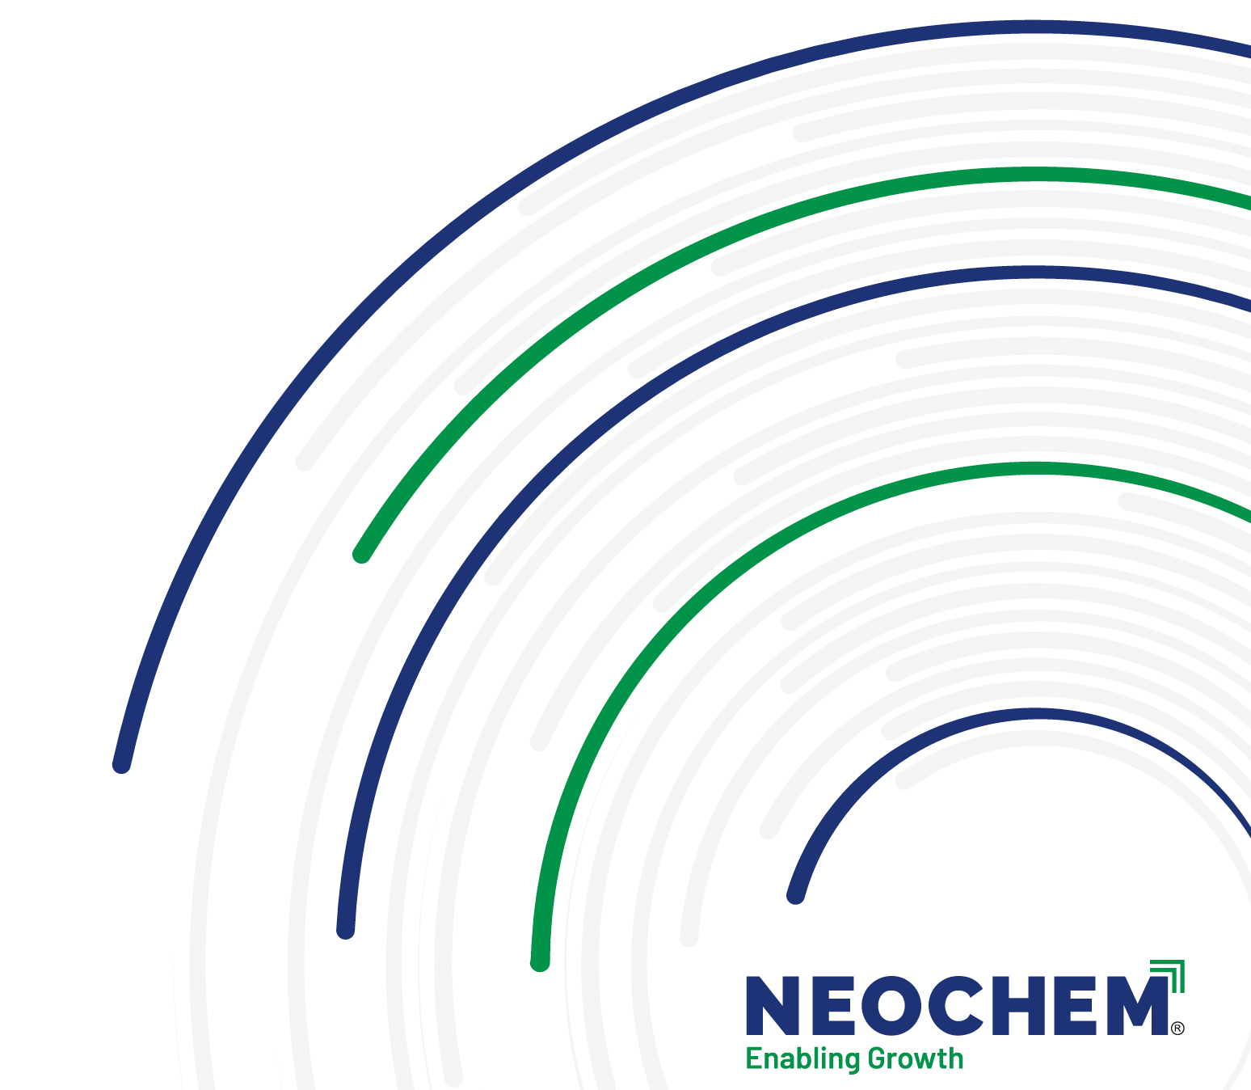
Simplified & Integrated
Polyester Cotton Processing

Slide 2

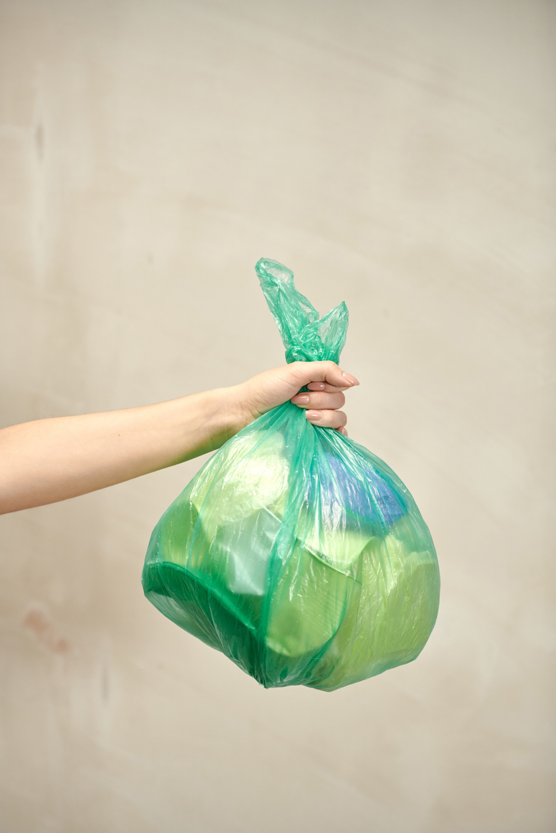










Water Saving
PES Scouring
PES Dyeing
Combined Soaping
Cotton Bleaching
Time Saving
Neochem
Integrated PC Processing Solution
Energy Saving
Overall Efficiency

Slide 3
FABBRITE 9002
ONE BATH TRIPLE ACTION
One Bath Bleaching and Dyeing
Resource saving
Low Effluent
Ease of use
Quality Assurance
Combines PES souring, Co Bleaching and PES dyeing
Reduces Water consumption and shortens the process
Reduction in load of Effluent
Optimized Dosing, low foaming
Excellent Dyeing Effeciency

Slide 4
AMPINOL RDP-CW
One bath washing off agent for Polyester and Dyeing
One Bath Soaping for PES and CO
Superior Dispersing Properties
Excellent fastness properties
Reduced Cycle time
Suitable for Exhaust and continious

Slide 5
Conventional Process
Total No of Baths : 13
Total Hours of Processing : 10 Hours
Total Liters of water* : 10,400 lts
*Assumption : 100 kg of fabric, 1:8 MLR

Slide 6
FabBrite 9002 Process
Total No of Baths : 10
Total Hours of Processing : 8 Hours
Total Liters of water* : 8000 lts
*Assumption : 100 kg of fabric, 1:8 MLR

Slide 7
Conventional vs FabBrite Process
01
02
03
04
25% Water Saving
20% Energy Saving
20% Saving on Time
Less Labor Required
Significant reduction in water consumption compared to conventional methods.
Lower energy requirements deliver cost and environmental benefits.
Streamlined processes reduce cycle time per batch significantly.
Automated systems minimize manual intervention and workforce demands.

Slide 8
Value Benefits
Simplified and Integrated Process
Reduction in Inventory cost
Reduction in Water, Energy and Labor cost
Reduction in Effluent load
Bio Based Product
Sustainable solution
Safe chemistry
High Fastness level
Meets end consumers demands
Durability of fabric
Compiles with all the Certifications
ZDHC gateway
GOTS complaint

